Slide 1
Capstone Project
Machine Learning Nanodegree
Abdullah Ahmed Sayed
03/04/2018
Definition
Project Overview:
License Plate Recognition with using the camera’s input as video or picture algorithm be able to detect all License in the frame and then extract Plate numbers.
As computer getting better at understanding images ,I use machine learning Computer vision field and convolution Neural network for detecting the license and extract plate numbers then the computer can use license number to extract information about the vehicle Who the owner of the car(Security team at university)
Problem Statement :
1- Scrap web for image of license plate and other images not license plate(people,car Parts,etc.)
2- train Sigmoid Classifier if the image contain license plate or not
3- use sliding window to extract ROI in input image extract license plate in the image
4- create images for Characters and numbers(A→Z,0→9) for five different fonts
5- create Softmax Classifier for recognize the Character (we have 36 class from A→Z , 0→9)
6- extract ROI
7- Predict License Numbe
The final Solution will be: Detecting the license plate number from an image.

Slide 2
Metric:
I will use accuracy as metrics for my models (License Classifier,and digits Recognition) to see what the percentage of Corrected Classified with the all data.
Accuracy = (True Positive+True Negative)/data Size for computing the loss for first model (classify license) Mean Square Error which update the weight base on the average of difference of True label and predicted label.
False negative(where the model predict license and there is not) for license identification : we can check the size of the ROI or we can check If there is text inside the license plate or we can enter kind of regular expression for the corrected license plate numbers (area code + number).
input_image
Text_detection
Character_splitting
Character
Classification
To be able to detect license plate number ,first I build multi layer model with single sigmoid output for detect and localize the license plate,then extract the license number with contours, then build second multi layer model with multi output for the computer to recognize digits/characters in the image.
output

Slide 3
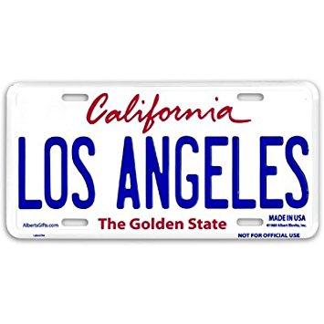
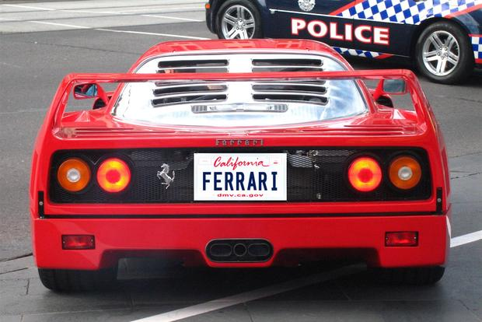

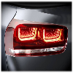
Analysis
Data Exploration:
There are two different type of datasets
1- images contain(not) License plate resized to (100x100)
Where contain License plate Labeled = 1 , not contain license Images for people, car parts , animals , and empty streets Labeled = 0
2- images contain different shape of Characters also resized (100x100)
Where each unique character Label as it’s own Class
1- The data at first model (classify license) contain
Training Examples: 725
Testing Examples: 128
2- the data for the second model (recognize Characters/number) contain:
(I create the data 8 different font for every character/number)
Training Examples: 499
Testing Examples: 36
Examples images:
Character
License
Not License
Input Image

Slide 4
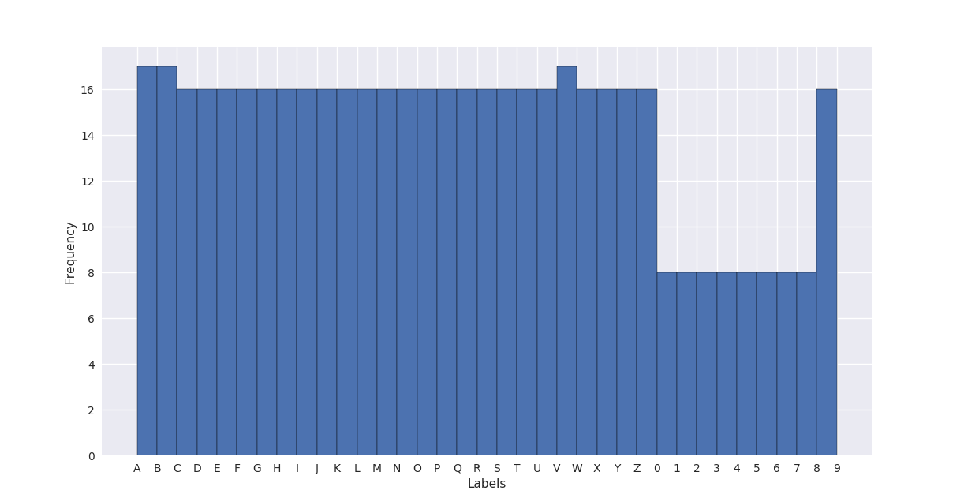
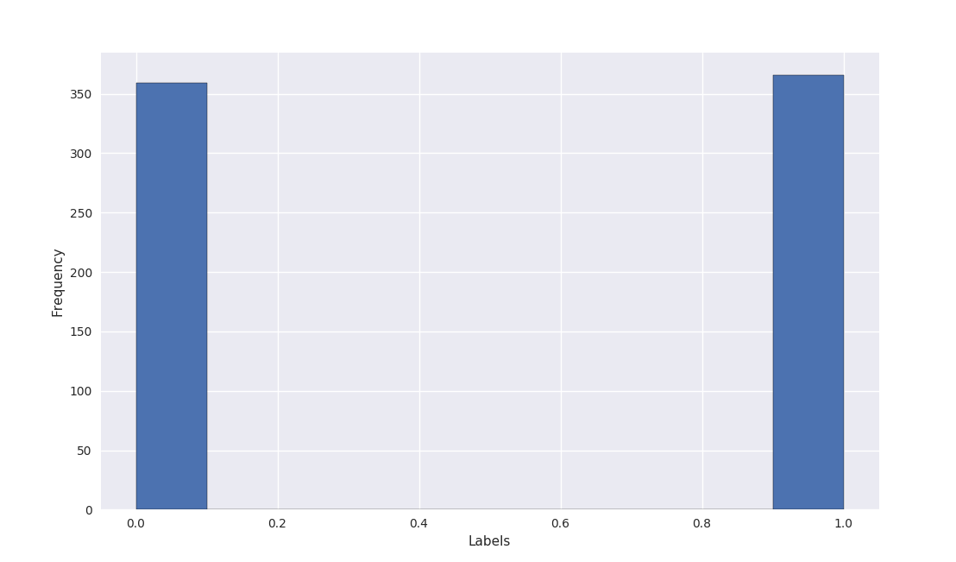
Data Visualization:
Draw histogram for the Label classes distribution for 2 models license image and characters/numbers images
License and No license Images
For Characters and Numbers

Slide 5
Algorithms and Techniques:
At the beginning After Preprocessing I create a model With CNN to classify license plate form Not license plate,I use Input shape of (100,100,3) create the architecture below , each Convolutional layer consist of number of filters and each filter consist of 3 channels (R,G,B).
I
N
P
U
T
C
O
N
V
P
O
O
L
C
O
N
V
P
O
O
L
C
O
N
V
P
O
O
L
F
L
L
A
T
T
E
N
D
E
N
S
E
Output
D
E
N
S
E
(100,100,3)
16
filters
32
filters
64
filters
500
node
1
node
# How CNN Work : At the first convolution layer we specify 16 filters which correspond to detect 16 pattern in the input image the model learn the weights for detect this pattern in the image after convolution layer there are Max pooling with pool_size = 2 to decrease the size of the input to the next layer (instead of (100x100) to be (50,50))
After sequence of Convolution layer (32,64) and MaxPooling to get more details about the input image We flatten the output from the last layer to fed it as input to Dense layer,and in all the previous layer (not Pool) we apply relu activation function for nonlinearity , in the last Dense output layer with only one node we apply sigmoid function to get the output in form of 1 if there is license and 0 If there is no license in the input image
# After Training the model and saving the best Weights , then used Sliding window technique to detect license plate in the image then extract the license part from the image.
# What is sliding Window and pyramids?
Sliding window:Try to find the object in the input image by divide the image into small windows,and then input this image to the model.
Pyramids: technique for return different scale of the input image , specify min size and Scale which specify how many layer of the image we want to return the smaller the scale is the more layer will be returns.

Slide 6
Benchmark:
I build two neural network model one for predict license in the image and the other one for detecting character in the image (locate in ‘character_neuralModel.py’ , ’license_neuralModel.py’) the first model (license_neuralModel.py) with accuracy = 0.47 second model (character_neuralModel.py) with accuracy = 0.027
Methodology
Data Preprocessing:
# First model (license detection)
My dataset (images) locate in two folders,first folder contain image of license plate locate in path ‘Pictures/Train_Images/plate_images’ , and the second folder contain other images than license plate locate in path ‘Pictures/Train_Images/other_images’
1-Starting with loading the images of license plate
2- resize the images into the same size (100x100)
3- adding labels to the images y = 1
4- append the data into list x_y
5- loading the images of other items (not license)
6- resize the image to the same size (100x100)
7- adding labels to the images y = 0
8- append the data into list x_y (using vstack)
9- randomize x_y to remove any bias in the data
10- split the data into training,validation,testing
#Second model (classify Character/number):
My dataset (image) locate in 36 folders ,folder for each character/number from A→Z,0→9
Folders in path ‘Pictures/Train_Images/TrainChar’
1- initialize letters_list with all class name (example:’A’,’B’,’C’,…)
2- loop over each element in the list add all the image in the path ‘Pictures/Train_Images/TrainChar/’+letters_list[i] (using glob to insert all files in directory)

Slide 7
# Second mode
3- resize all the image to same size (100x100)
4- and for every folder add unique label start from 0 to 35
5- append every folder images with labels into x_y
6- after adding all images in all folders randomize the data to remove any bias
7- split the data into training,validation,testing
8- use One-Hot-Encoding for y_training and y_validation define number of unique class in the data set (=36) and use keras library to_categorical to assign one-hot-encoding
Implementation:
After Loading the data and split it into training ,testing,and validation I use CNN for training the model instead of using Neural network because neural network take input in 1 dimension shape instead of 2-D input image but CNN take the input as matrix which 2-D information is not entirely lost (local connectivity)
How CNN work:
We break the image into small pieces in shape of window (width and height) this called filter we specify the width and height in parameter kernel_size then move the filter(window) on the input image we shift the window on the image base on step parameter default = 1,we use the padding =’same’ where the size of the output will be as same of size of the input ,and we add activation function for nonlinearity activation = ‘relu’
My First model(License Detection):
We define the model and then add layers to the model:
# first layer I define number of filter to 16 where each filter will detect pattern in the image, make the window size = 2x2 (kernel_size=2) and the size of the output from the layer equal to the size of the input (padding=’same’) and add nonlinearity which is ‘relu’ activation function [max(0,x)], and only in the first layer specify the size of the input image to the model (100,100,3).

Slide 8
After every convolution layer we add Max_pooling layer with parameter pool_size = 2 to minimize the number of node to the half take window in size of (2x2) and return the max value of 4 number in the window
# second convolution layer the same parameters of layer one but increase number of filter to 32 the adding Max_pooling layer to decrease number of nodes add Dropout for this layer to prevent over fitting Dropout(0.2) close the chosen node in the layer 20% of training process
# third convolution layer the same parameters but increase number of filters to 64 then add Max_pooling and Dropout layers
# fourth layer then flat the node from 2-D to one dimension then use that as input to Dense layer with number of node = 500
# final layer (output) Dense layer with number of node = 1 and activation function sigmoid so the output = 1 or 0 to indicate if there is license or not
After building the mode we compile define what loss function to use = ‘mean_square_error’ difference between real value and predicted value and what kind of optimizer and metrics = ‘accuracy’ then train the model and specify to save only the best result
After finishing the model and train it the second step is to localize where the license is in the image I use sliding_window and pyramid for that.
Window_sliding : define width and height of window the slide this window on the image then extract this window and resize it and predict if license locate in this window if so save ROI in possible license.
Pyramids: take image as input along with scale and min_size parameters where scale define what the next layer size (the largest the scale is the more layers we get) and min_size is the last layer image size , then yield all images with different scale.

Slide 9
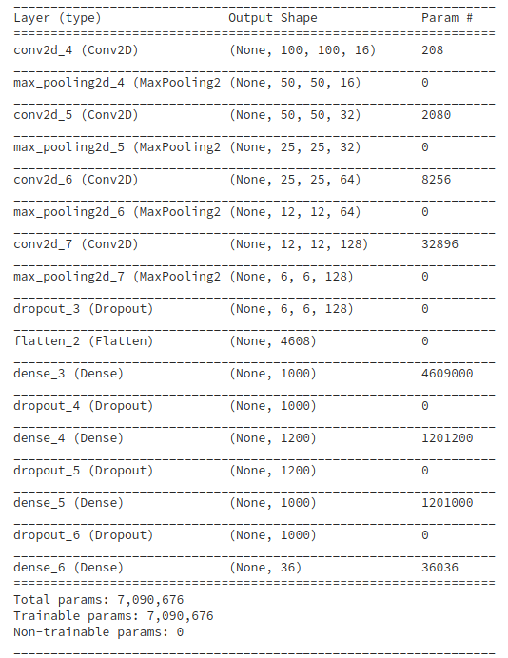
Refinement:
For Character Recognition I start with model consist of 3 layer of Convolution and Max Pooling layer with filters (16,32,64) and Dense layer of size 500 node the test accuracy = 51%
Then adjust the parameter as in the image on the right to get the test accuracy = 70%
Model Evaluation and Validation:
When fitting the data we specify the validation set to the model (which is separate data from training data) which validate the model each epoch to make sure that train_loss close to valid_loss to prevent over_fitting. The final model has the best hyperparameters.
Trying different parameters for the model different number of layers different number of window_size =5,=4 try different input image size (200x200)|| (300x300) ,different numbers of filter and the best model architecture is on the figure on the right. The final parameters is the best accuracy on training validation and testing.
And yes the model is robust enough for any input image check if there is any license in the image if there are license plate use sliding window to localize it and then extract the license number from the plate
Justification:
Compare the result of my final model with my benchmark for the final model I use the CNN model use information of 2-dimension (local connectivity) not like neural network (flatten input)
The result of first model (license detection) accuracy for my final model = 98% where benchmark model accuracy = 47%
The second model (character recognition) accuracy for my final model = 70% where benchmark model accuracy = 0.027

Slide 10
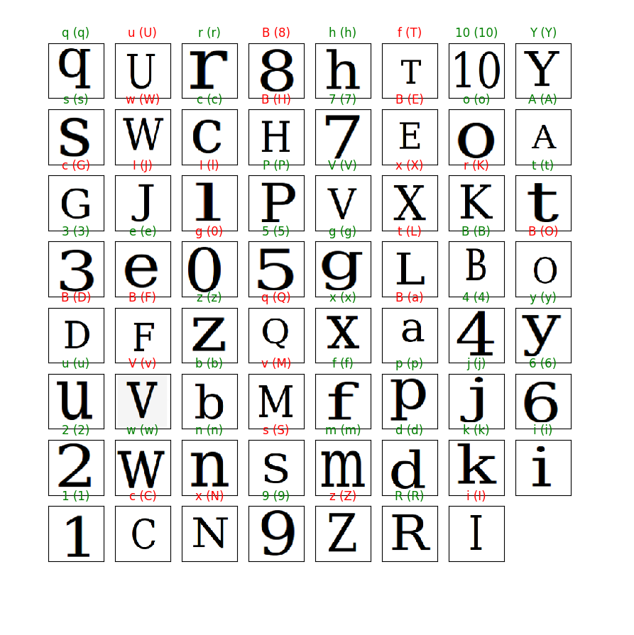
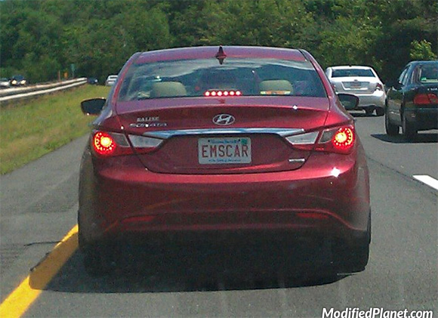
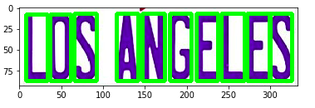
Free-Form Visualization:
Conclusion
Second model (recognize characters/numbers) test set images and apply the model to predict which character in the image where the value inside bracket and predict value without if the both values are the same the color will be green if wrong the color will be red.
The output of first model show the input image with detecting license plate in the images
Input Image
Final step use opencv find contour function to extract ROI for every character in the image then apply the second model to predict which character in the image
Predict Character
Extract Character

Slide 11
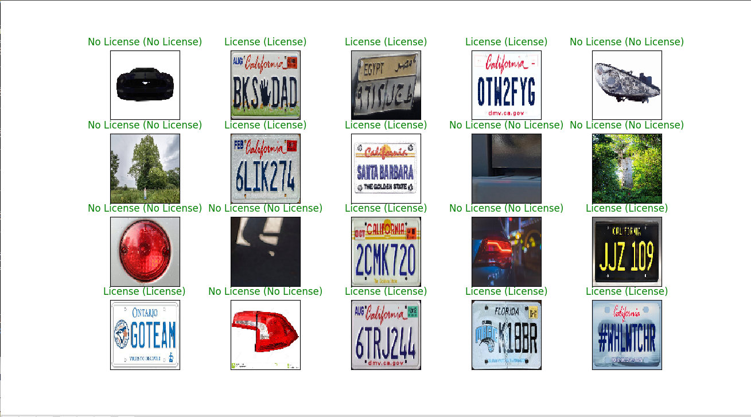
The result of the model one (license || not license) prediction result on the test images on the test dataset where the true value of the image locate inside the brackets () and predicted value the other value if the color is green the predicted was right==truevalue
Predicted License?

Slide 12
Reflection: summarized steps:
# Start build License detection:
1- starting with gathering the data set
2- load the dataset
3- add labels to the data set (0→no-license,1→license)
4- split the data into train validation and testing
5- build the model
6- fit the data into the model
7- Check the accuracy of the model on the test set
# second Localize the license plate in the input image:
1- starting with input the image
2- make copy of the image and resize to predict if contain license or not
3- create sliding window with fixed width and height and slide it on the image
4- extract the sliding window and resize and use the first model to predict if contain license
5- if the prediction come positive = 1 save the license into possible license list
6- when the is no more image part to extract (sliding_window_width > image_width || sliding_window_height> image_height) apply pyramids
7- pyramid take inputs the (image,scale,min_size) and yield different image scale then apply sliding_window on every image
# Third I create the model to predict the character/numbers in the license plate:
1- starting with creating the dataset
2- load the data set
3- add Label to the data set (we have 36 different class) A→Z,0→9
4- split the data into train validation and testing
5- build the model
6- fit the data into the model
7- Check the accuracy of the model on the test set
# final step: use opencv library cv2.findContours() to detect every single character then extract every contour and fed it into the second model to predict which character in the contour

Slide 13
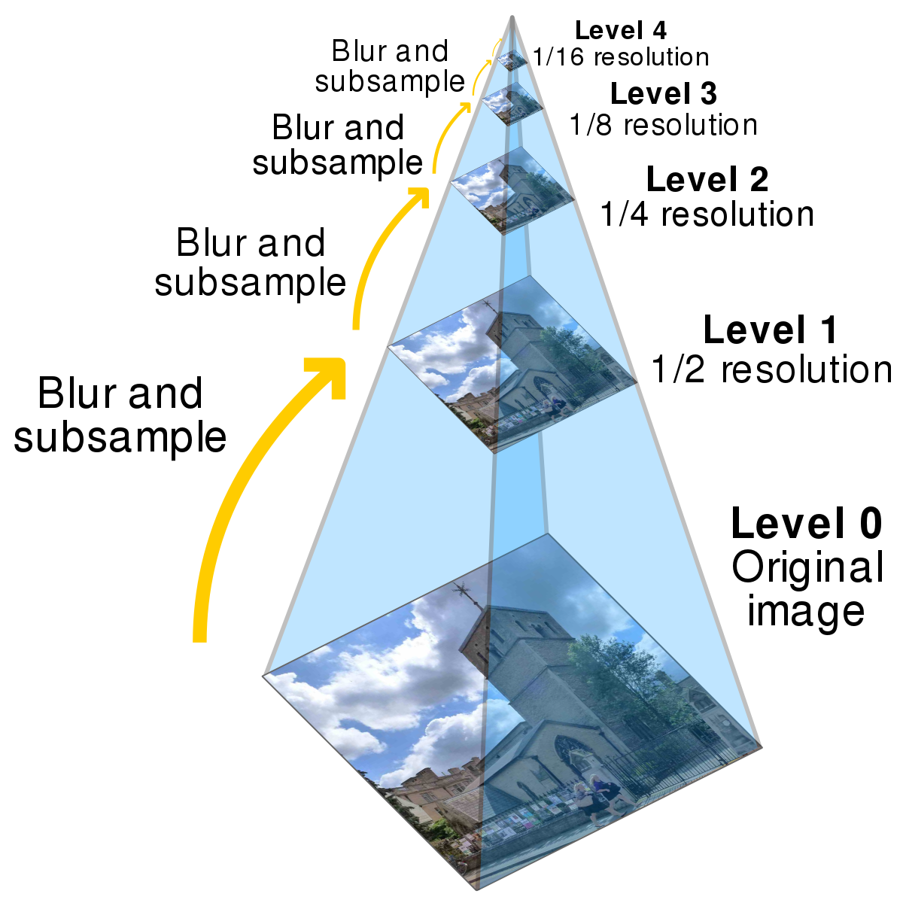
Interesting aspect:
I found Sliding_window and Pyramid very intersting: where I take the image and send it to the pyramid function with min_size and scale(how many layer to return) and yield all image with different scale , then for every image with different scale apply sliding_window to search on the license in the image.
Improvement:
# use Regularization for better result in license Plate If detect street sign or house number with letters from Regular expression from the license plate now that not valid license plate number.
# use word Correction in the final result to get better result instead of Ca1ifornia→California
# gather more image dataset for better accuracy result.
# apply distribution on data set (artificial data synthesis) increase data set

